Slide 1
Crosswalk on Tizen Tizen Security F2F
Vannes, France
Sept 2014
Terri Oda

Slide 2
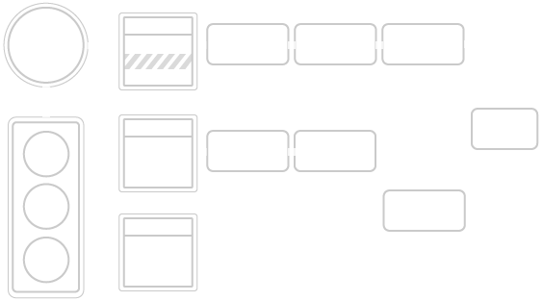
Crosswalk Overview

Slide 3
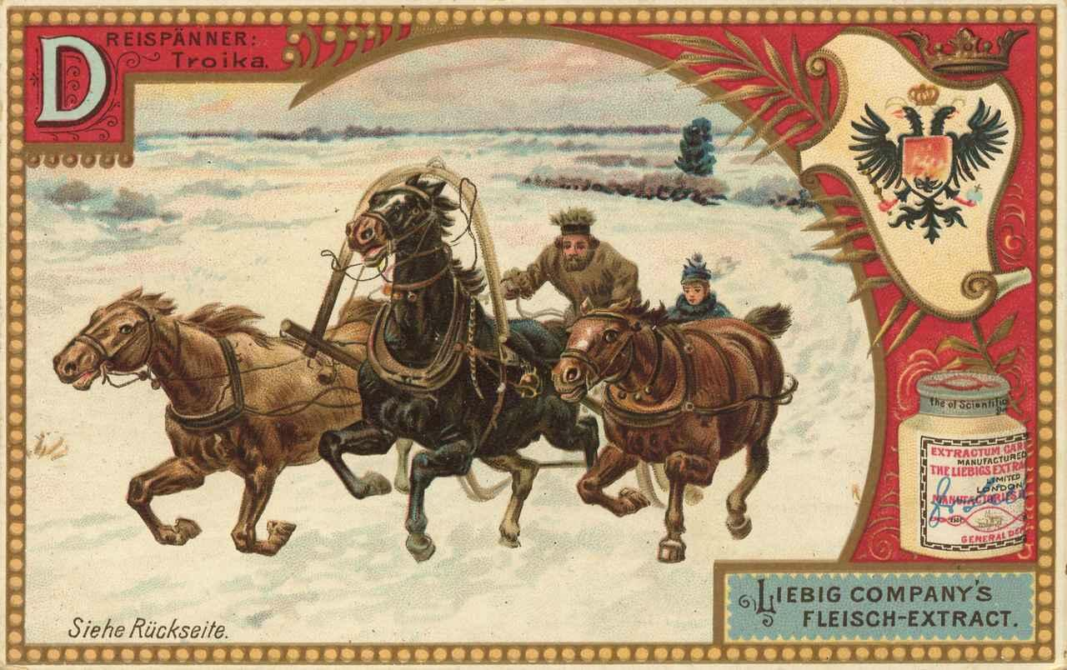
Application Installation
Copies files to /home/$user/.xwalk-service/applications/$appid
Sets Cynara rules using security-manager
What about extensions?
built-in extensions installed as part of platform in /usr/lib/tizen-extensions-crosswalk/
3rd party extensions – installed with application
Notes:
Application db may be going into /home/app?
Multi-user: everything per user should be $home
-> need to know where and how 3rd party extensions are installed

Slide 4
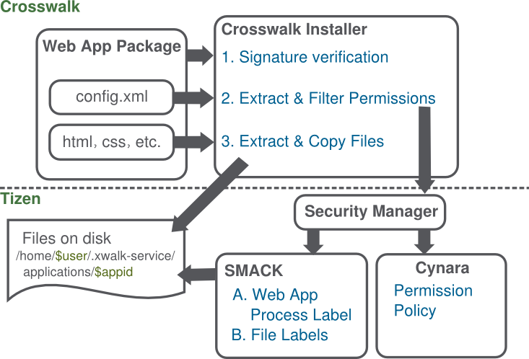
Crosswalk Installer
Notes:
Fix info about file locatoins on previous diagram

Slide 5
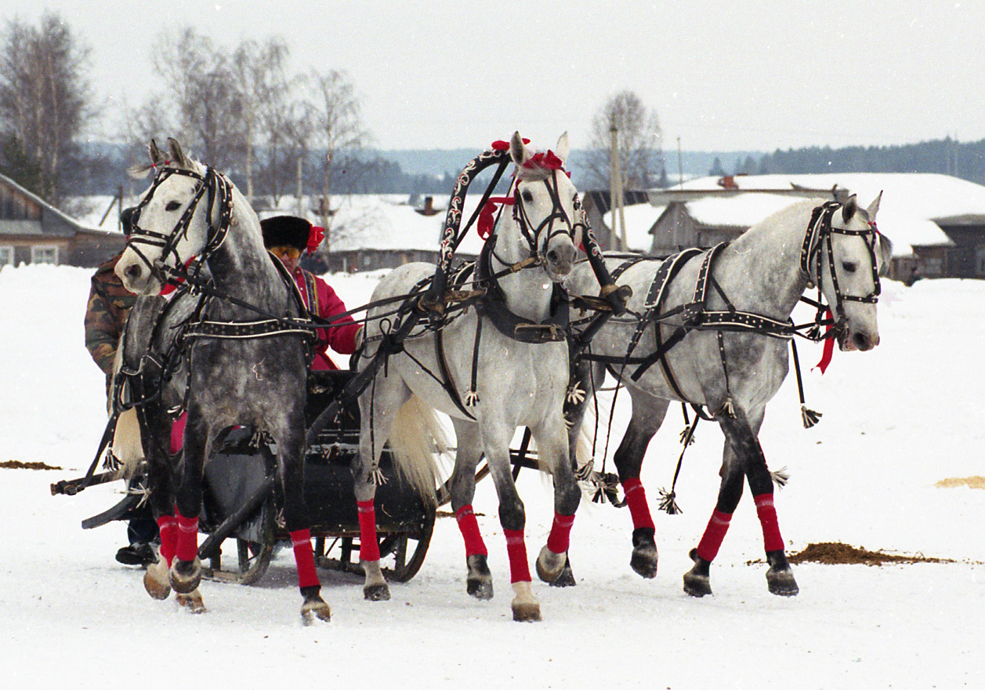
Application Launcher
Launcher forks to create extension process
Browser forks to create render process
Each one sets SMACK labels for those processes using security-manager

Slide 6
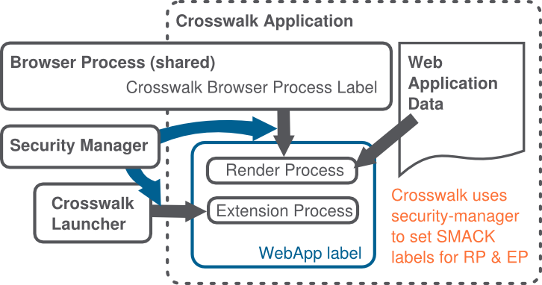
Crosswalk Launcher
Notes:
Fix this diagram
Who is the parent of RP? BP. -> so BP can set the smack label?

Slide 7
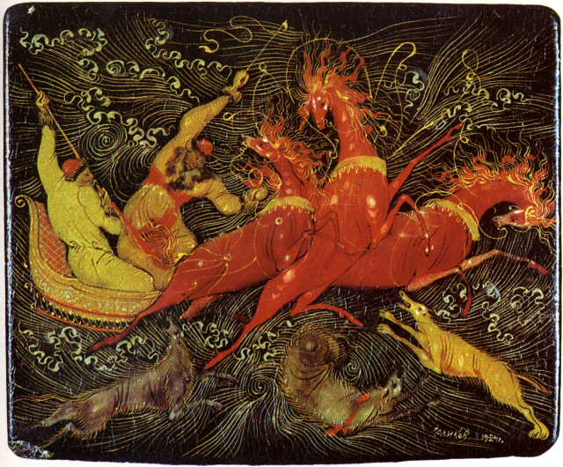
Crosswalk Runtime
Extension Process and Render Process run under WebApp-specific SMACK label
We have to treat this is code that is both untrusted and requiring our protection
Any permissions requested are handled by Tizen OS
Browser Process is shared, runs under separate label
Aware of SMACK label for WebApp, uses that to query Cynara (directly) to check permissions
Browser Process actually only handles 5 privileges, rest are in extension process
Notes:
geolocation, media, web storage, history, ??

Slide 8
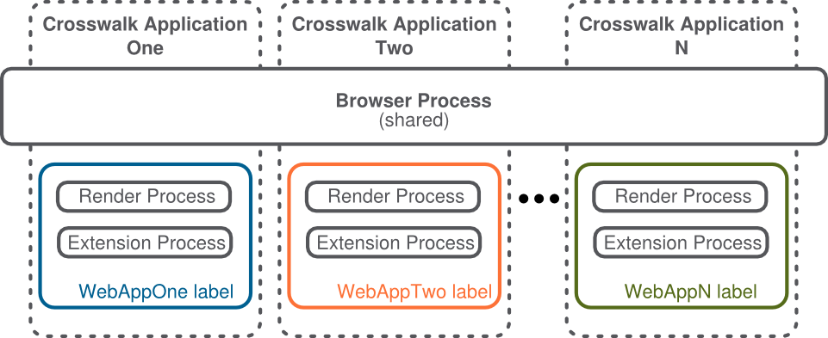

Slide 9
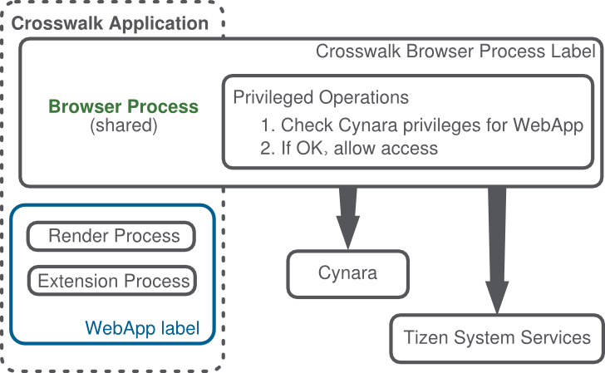
Crosswalk Runtime
Notes:
List those 5 modules: geolocation, media, web storage, history
Everything else is in extension process
Remove curved arrow

Slide 10
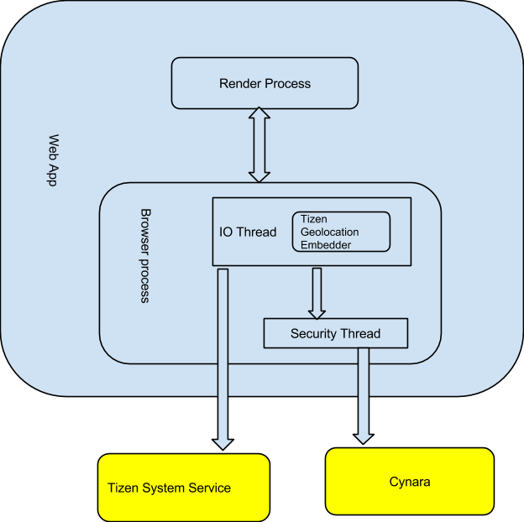

Slide 11
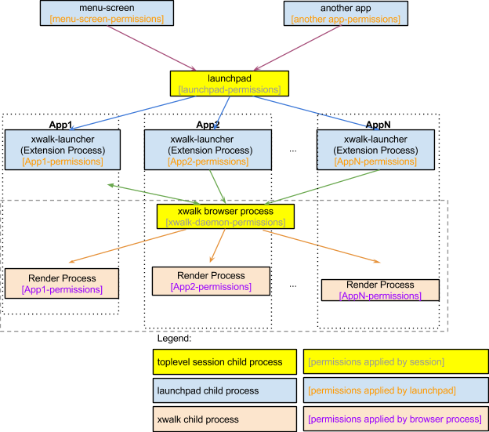

Slide 12
The general process is as below:
user trying to launch an application by clicking the application icon in home screen or another application throwing an intent to launch web app, which result in a series of IPC message passing between multiple processes and eventually the launchpad_daemon is notified of this action.
The launchpad_daemon fork a child process xwalk-launcher and xwalk-launcher create a new xwalk extension process instance. xwalk-launcher set SMACK label for itself.
xwalk-launcher send an dbus message to running application manager (Browser process). Application manager launch web application and start a new render view(render process)/
Render process set itself SMACK label Render process adds itself to required supplementary groups. To be allowed to do that, it also needs CAP_SETGID capability.

Slide 13
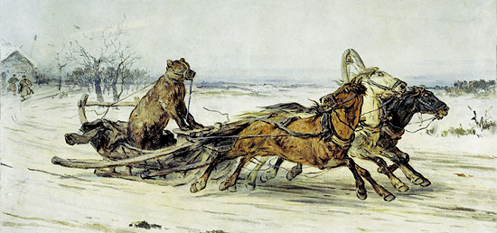
Cynara/security-manager issues
Some permissions require explicit user consent (e.g. download a page): will cynara/security-manager provide a way to check with the user? (pop-ups?)
Security-manager: How will this dialog be configured?
Dropping privilege with security-manager?
What privileges will change in Tizen 2 -> Tizen 3?
Notes:
Some permissions require explicit user consent (e.g. download a page): will cynara provide a way to check with the user? (pop-ups?) → security-manager and cynara will do this?
Change this slide to ask about this and get confirmation
Security-manager: How will this dialog be configured?
Dropping privilege with security-manager?

Slide 14
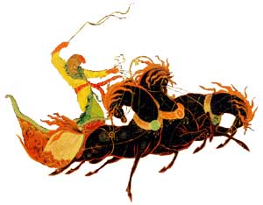
Application Signatures
Are we doing application signatures?
Old web runtime only allowed privileges based on application signatures – will we do the same?
Is there any differentiation based on signature for the application privileges?
Must be able to check fingerprint of key against preloaded list of certificates
Currently there is no mapping
How do we configure the privilege level for a certificate?

Slide 15
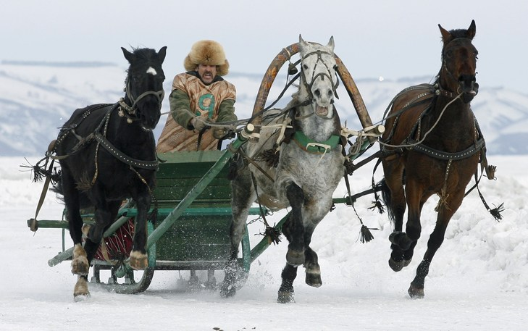
Content Security Policy (CSP)
Not fully implemented (although Chromium/Blink supports already)
Plan is to read from manifest
W3C standard is still being defined
Tizen has a default security policy (inherited from WRT)
Note that this is not true on other crosswalk platforms
Crosswalk does not enforce CSP on extensions
Notes:
Security review: probably not ready yet
Ask about privileges in Tizen 3 vs 2

Slide 16
Troika pictures
janwillemsen vervoer Liebig- troika https://www.flickr.com/photos/8725928@N02/7061257609
"Troika akron" by Лена - Own work. Licensed under Public domain via Wikimedia Commons
http://commons.wikimedia.org/wiki/File:Troika_akron.jpg#mediaviewer/File:Troika_akron.jpg
"PalekhTroikaWolves" by http://palekh.narod.ru/g/golikov/golii_04.jpg. Licensed under Public domain via Wikimedia Commons
http://commons.wikimedia.org/wiki/File:PalekhTroikaWolves.jpg#mediaviewer/File:PalekhTroikaWolves.jpg
http://bestspb.ru/imgs/russian/russian_troika1.jpg
http://www.horses.ru/horsemanship/main_troika.htm
http://www.56thparallel.com/wp-content/uploads/2013/07/troika-race.jpg

Slide 17
Q & A

